Slide 1

Islamorada, Village of Islands
Building Permit Allocation System (BPAS)
Community Workshop
July 30, 2024

Slide 2
AGENDA
Welcome & Introduction of Staff
Brief Presentation
General Q & A (10-15 minutes)
Roundtable Discussions ( 30 minutes)
Short Break
Report Back to Group from Roundtables/Final Q & A (20 minutes)
Next Steps
Adjourn

Slide 3
Building Permit Allocation System (BPAS)
Division 30-IV-11 of the Village Code
Purpose & Intent
Facilitate implementation of goals, objectives and policies set forth in the village comprehensive plan;
Regulate the rate of growth in order to further deter deterioration of public facility service levels, environmental degradation and potential land use conflicts; and
Encourage redevelopment of residential and nonresidential development and to encourage affordable housing.

Slide 4
General Background Information
1972 – Area of Critical State Concern (ACSC) Program was adopted
1979 – Florida Legislature designates the Florida Keys as an ACSC
1992 – Monroe County adopted Rate of Growth Ordinance (ROGO)
2002 – Islamorada adopted BPAS Ordinance with an original number of 302 allocations
2012 – Department of Economic Opportunity (DEO) completed the hurricane evacuation clearance time modeling and found that with 10 years worth of building permits, the Florida Keys would be at a 24-hour evacuation clearance. Based on that DEO determined the remaining amount of allocations county wide would be 3,550. Islamorada received an additional 263 for a total of 565.
2017 – The Village entered into a 380 Agreement with DEO, Monroe County, the cities of Key West, Layton, and Marathon in which the Village received at additional 10.25 allocations.

Slide 5
Current BPAS Situation
3 Market Rate Allocation Available
10 Affordable Allocations Available
300 Early Evacuation Affordable Allocations Available
23 Administrative Relief Allocations
54 Permits in the Queue
The Village Council has adopted a Temporary Moratorium on Market Rate BPAS Applications to expire February 2025.
A Temporary Moratorium on Administrative Relief Applications is before the Village Council for second reading on August 8, 2024.

Slide 6
Hurricane Evacuation Modeling Update
In 2023 the Department of Commerce (formerly DEO) and the Division of Emergency Management (DEM) ran an updated hurricane evacuation model based on the 2020 Census and other relevant data.

Slide 7
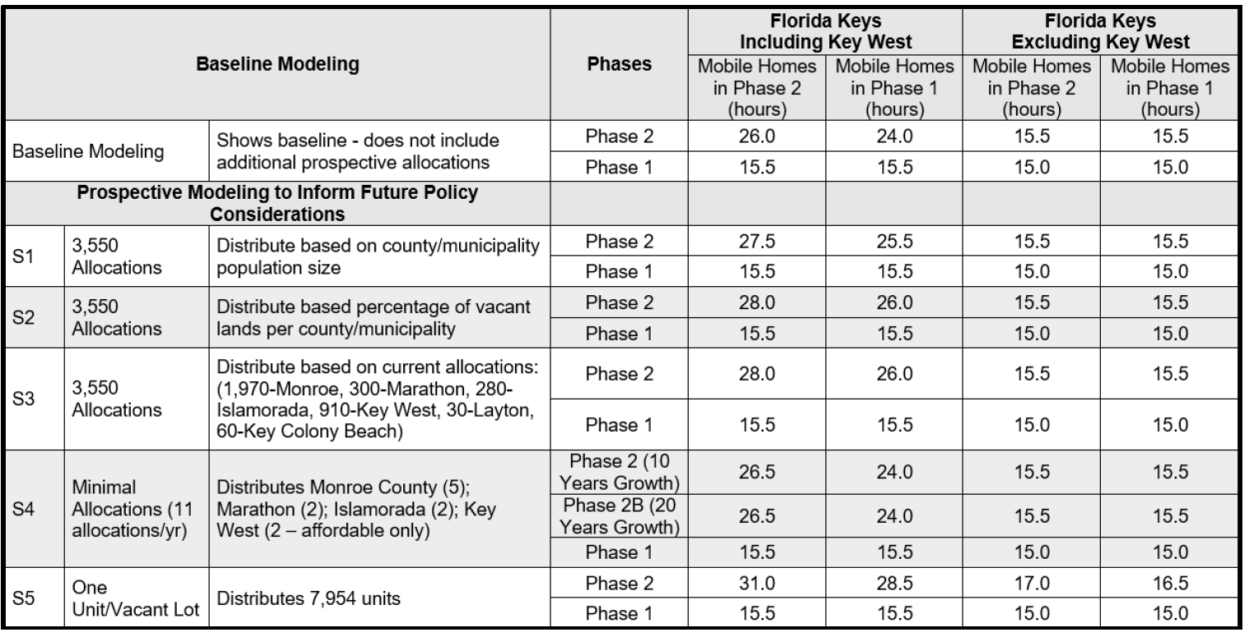
2023 Clearance Times Summary

Slide 8
Vacant Parcel Analysis
The Village Planning Staff undertook a Vacant Parcel Analysis recently.
The following criteria was used:
  Residential zoning districts
  Parcel size (must meet the minimum sq ft for residential lot size)
  Parcel is “vacant” according to Monroe County Property Appraiser data as of 2022
The initial review produced 212 parcels. A secondary review was completed and the Staff removed any anomalies and the list of vacant parcels is now at 178.
Staff is continuing to look at this list and ways to reduce the vacant parcel liability.

Slide 9
ROGO/BPAS Questions
Being led by Monroe County
Board of County Commissioners (BOCC) will make a decision at its December meeting.
The Village would like to provide input to the BOCC and expect to have a report to the Village Council for its October meeting.
Questions to answer:
  Do we want more allocations?
  If yes, how many?
  What kind? Market? Affordable? Both?

Slide 10
Questions?
Breakout sessions
Report Out/Discussions
Next Steps

Slide 11
Thank You for Attending!
Contact Information:
  Jennifer DeBoisbriand, Planning Director
  Jennifer.deboisbriand@islamorada.fl.us
  (305) 664-6440

